Slide 1


Slide 2
MINE EXPLOSIONS

Slide 3
What is an Explosion?
Explosion is a sudden combustion process of great intensity.
It is accompanied by release of large quantities of heat energy and development of pressure.
In explosion, the original gas (methane) and solid substance (coal) is converted instantaneously into gaseous products.
An explosion is also invariably accompanied by violence on a large scale.

Slide 4
MINE EXPLOSIONS
Mine explosions are generally regarded as a serious and constant hazard in underground coal mines.
In coal mines, explosions are caused
  By ignition of firedamp (Fire damp explosion) or
  By ignition of coal dust (Coal dust explosion) or
  By both (Mixed explosion)
In metal mines, explosions are due to sulphide dust (iron pyrite).

Slide 5
In India, between 1900 and 1980, 21 explosions occurred.
The worst disaster due to mine explosion took place in Dhori Colliery (1965) when 268 miners were killed.

Slide 6
FIREDAMP EXPLOSIONS
Firedamp:
The term firedamp refers to the natural gas mixtures emanating from the strata of coal mines.
Such gas mixture consists chiefly of methane (CH₄), with small traces of other combustible gases like ethane (C₂H₆) and ethylene (C₂H₄).
Therefore, firedamp is often considered synonymous with methane.
Methane burns in air when ignited with a pale blue flame but when it is mixed with air, it can explode on ignition.
The combustion or explosion takes place according to the equation
CH₄ + 2(O₂ + 4N₂) = CO₂ +2H₂O + 8N₂

Slide 7
Two factors are essential to cause a firedamp explosion:-
  Firedamp in inflammable explosive proportions, i.e. mixed with the right amount of air should be there and
  A suitable igniting agent should be present.

Slide 8
Inflammable Mixture:
Inflammable mixture is that which contains CH₄ and air at certain proportions, and which, when ignited will allow the flame to be self propagated throughout the mixture in all directions, independent of, and away from, the source of ignition.

Slide 9
Limits of Flammability, Flammable Limits, or
Explosive Limits:
The flammable limits of methane-air mixtures are the limits of conc. of CH₄ in air between which a flame can be propagated throughout the mixtures.
The boundary-line mixtures with min. and max. conc. of CH₄ in air, which if ignited, will just propagate flame are known as the lower and upper flammable or explosive limits.
The lowest % of CH₄ in air that yields an inflammable mixture is called the lower flammable limit (LFL).
The highest % of CH₄ in air that yields a similar mixture is called the upper flammable limit (UFL).

Slide 10
The flammable limits of firedamp in air:
Lower limit of inflammability: 5% (33 g/m³) of CH₄ in air
Higher limit of inflammability: 15% (100 g/m³) of CH₄ in air

Slide 11
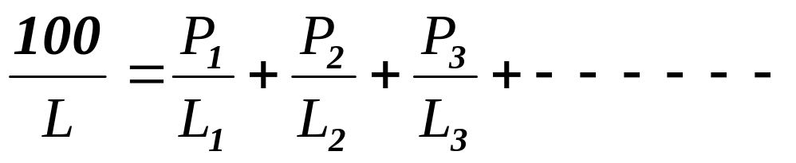
Presence of other combustible gases like ethane, CO, H₂ etc. reduces the LFL of the mixture.
LFL of mixture of gases can be determined by the Le Chatelier relation:
Where
P1, P2, P3….. are the percentages of the component gases in the mixture (P1 + P2 + P3 + …… = 100) and
L1 , L2, L3 ….. their percentage lower limits.

Slide 12
Flammable limits of combustible gases
Gas | % by valume
 | Lower limit | Upper limit
Acetylene (C₂H₂) | 2.5 | 80
Carbon monoxide (CO) | 12.5 | 74
Ethane (C₂H₆) | 3.2 | 12.5
Ethylene (C₂H4) | 3.1 | 32
Hydrogen (H₂) | 4.1 | 75
Hydrogen sulphide (H₂S) | 4.3 | 46
Methane (CH4) | 5.4 | 14.8
Ammonia (NH3) | 15 | 28

Slide 13
Coward’s Diagram
Shows the limits of explosibility with different percentages of firedamp and oxygen.
It has significance
  during sealing off a fire in a gassy mine, and
  when reopening a sealed off area.

Slide 14
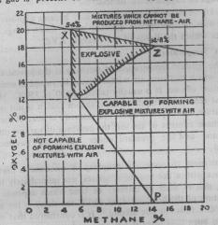

Slide 15
Coward’s Diagram
All mixtures lying within the triangular area XYZ, are in themselves explosive.
All mixtures lying to the right of PYZ contain too much CH₄ to explode, but they will form explosive mixtures when mixed with the right amount of air.
All mixtures lying to the left of PYX are neither explosive, nor capable of forming explosive mixtures with air.
Lower limit of explosibility remains almost constant at about 5.4% for all percentages of O₂ down to about 12.5%.
The higher limit of explosibility gradually decreases from 14.8% to about 6% with decreasing O₂ %.
No percentage of firedamp is explosive when the O₂ % is 12 or less.
A firedamp-air mixture may become explosive when diluted with an appropriate quantity of air which brings the new mixture within the limits of the triangle XYZ.

Slide 16
Factors affecting the inflammable limits:
The limits of flammability are not fundamental characteristics of the gas but depend on the experimental conditions.
The limiting percentages or limiting mixtures of flammability are influenced by
  Presence of other combustible or inert gases
  Temperature, pressure and intensity of turbulence
  Diameter of the experimental tube
  Direction of flame propagation
  Oxygen concentration
  Intensity of igniting source
  Presence of coal dust

Slide 17
Ignition Temperature:
The lowest temp. to which an inflammable mixture must be raised in order to set the mixture aflame is called the ignition temp. or ignition point.
The ignition point of pure methane in oxygen is 550°C.
Ignition temp. of firedamp-air mixtures usually taken as 650 to 750°C.

Slide 18
It is not a definite temperature but depends upon the
  nature of the source of ignition whether flame, spark, etc.
  shape and size of the of space where ignition occurs
  methane content
  temperature of the surroundings
  pressure
  oxygen concentration
  presence of other gases
  turbulence

Slide 19
The Lag on Ignition
The firedamp air mixture doesn't immediately burst into flame when it has been raised to its ignition temp.
The latter temp must be maintained for a definite interval of time to ensure that flame will appear.
The interval of time that elapses between the exposure of a CH₄ air mixture to an igniting source and the appearance of flame is called the preflame period and duration of this period is called the lag on ignition.
During this period the rate of heat production progressively increases and the temp rises.

Slide 20
The lag on ignition is not constant but varies with:
Temp. of the igniting source
CH₄ % in the gas mixture
Higher the source temp., shorter the lag on ignition.
  6.5% of CH₄ – source 700 ºC – Lag 11 seconds
  6.5% of CH₄ – source 1175ºC – Lag 0.01 second

Slide 21
Direct Blast and Backlash
Methane explosions are characterised by two distinct phases:
the direct blast and
the indirect blast or backlash.
In direct blast, a pressure wave of great force and speed travels ahead of explosion flame.
The backlash is caused by the vacuum arising out of cooling of explosion gases and condensation of water vapour.
It is of less intensity than the direct blast and traverses the same path backwards.

Slide 22
Explosion flames
When the concentration of CH₄ is greater than 9.5%, two types of explosion flame occur, the primary and secondary flames.
Primary flame propagates at a greater velocity and consumes the entire available oxygen.
The secondary flame is produced by the burning of unburnt gas with the help of the oxygen supplied by the backlash. It propagates slowly in the opposite direction to that of the primary flame at a lower velocity.

Slide 23
Effect of high press and temperatures
By suddenly compressing the gas mixture, both temp. and press. are raised simultaneously, and it has been found possible to ignite in this way a mixture containing as little as 2% and as much as 75% of methane.
If the press of gas mixture raised to 125 atm., the higher limit is about 46%.
This is important, because it shows that the press. waves or hot compressed gases, of an explosive may during shot firing, ignite a wider range of firedamp air mixture, in brakes or cavities behind the face

Slide 24
Effect of black damp on inflammability:-
Black damp (a mixture of CO₂ and excess N₂) has very little effect in diminishing the danger of an explosion
For all % of excess nitrogen or of ordering blackdamp upto about 35%, the lower limit of inflammability remains unaffected, being between 5% and 6%.
Higher inflammability is 14.8 when no black damp is present and it gradually falls to about 6% as the % of black damp increases upto 35% .
The upper limit and the lower limit then coincide.
When the % of blackdamp > 35%, the atmosphere becomes non-inflammable with any % of methane
If the blackdamp consists solely of CO₂ (a condition never met with in a mine) at least 25% of CO₂ would be required to render the mixture non-inflammable with any % of methane

Slide 25
EXPLOSION CHARACTERISTICS
Explosion flame temperature
Explosion pressure
Flame length
Velocity of propagation of flame or Flame velocity

Slide 26
FLAME TEMPERATURE
It is the temp. which occurs just at the moment of explosion of a flammable firedamp-air mixture.
It depends upon the
Concentration of firedamp
Uniformity of the mixture
Turbulence
Confinement, and
Heat losses
It is maximum at the stoichiometric concentration and is less at the lower and upper flammable limits.
The adiabatic flame temperature for a stoichiometric methane air mixture is 2,200 °K.

Slide 27
EXPLOSION PRESSURE
It depends upon the flame temp and confinement.
The maximum explosion pressure of methane-air mixture (760 mm Hg, 20°C) when ignited in a closed vessel is given as 7.2 bar.
In mine workings, explosion pressure is much higher than this; because the shockwave travelling ahead of explosion flame compresses any fire damp accumulation encountered on its way to a press greater than 1 bar.
Upon ignition of such an accumulation, the resulting explosion pressure will be much greater than 7 bar.
Therefore, severe damage due to explosions does not occur at the seat of explosion but away from it.

Slide 28
FLAME LENGTH
Experiments in the USBM Experimental Coal Mine showed that the length of flame increases as the gas concentration in a gas zone increases
It increases from the lower limit of flammability to about 12%, after which it decreases.
Length of flame is directly proportional to the
  volume of the zone and
  Concentration of firedamp in mixture
For a given roadway cross section, the total flame length is
  4.5 times the length of the gas zone for 9.5% mixture and
  5 times the length for 12% mixtures.

Slide 29
VELOCITY OF PROPAGATION OF FLAME
OR
FLAME VELOCITY
It depends upon the following factors:
Methane content of mine air:
Velocity of flame propagation increases with increasing firedamp content from the lower flammable limit upwards.
After reaching the maximum value at the optimum concentration, the velocity decreases.

Slide 30
Condition of gas mixture whether at rest or in motion:
From experiments it was found that maximum velocity of propagation is not greater than 0.6 m/s.
On the other hand, when the gas mixture is in motion, the velocity may quickly increase to few hundreds of m/s.

Slide 31
Point of ignition:
Location of the point of ignition within the body of gas mixture markedly affects the velocity of propagation.
If ignition takes place at the close end of a roadway filled with a gas mixture, the speed of propagation and severity of explosion are greater than when ignition takes place at the outbye end of the roadway.
When ignited at the outbye end, rapid burning rather than explosion develops.

Slide 32
Length of gas zone:
Experiments in gas zones in the USBM Experimental Coal Mine showed that
Velocity of flame propagation increases from zero at the point of ignition to a maximum at a distance of about twice that of the original length of the gas body.
The maximum velocity for the 7.5m zone is about 99 m/s and that for the 15m zone is 533 m/s.

Slide 33
Presence of Obstacles in the Path or Change in Area of Roadway Cross-section:
Obstacles cause turbulence of the air and greatly increase the speed of the flame.
Presence of objects or obstacles in roadway e.g.
  props,
  tubs,
  doors,
  brattice cloths etc. decreases its area of cross-section and the velocity of propagation rises to a few hundreds of m/s.

Slide 34
CAUSES OF FIREDAMP EXPLOSIONS IN MINES
Negligence of Miners
Use of damaged safety lamps and their improper handling
Blasting
Mine fires
Friction
Electric sparks
Other special causes

Slide 35
Negligence of Miners:
Smoking
Making fire
Opening of flame safety lamps, etc.
resulting in ignition of firedamp causes firedamp explosions.

Slide 36
Use of damaged safety lamps and their improper handling:
A safety lamp is safe only when
its various parts are clean,
in good condition,
all parts are properly assembled, and
is properly handled.

Slide 37
Blasting:
Blasting in coal, roadhead rippings represented a dangerous source of ignition of firedamp in the past.
Effects of Blasting:
  Flame produced by the explosive: lasts very short time – so no chance of burning
  The hot gases emitted: Cooled down rapidly –no chance of burning firedamp air mixture.
  Heat of compression: Sudden compression of a gas by 20 fold increases the temperature of the gas and ignite the gas.
With development of new and safer explosives and improved blasting techniques, the number of explosions due to this cause had decreased considerably.

Slide 38
Mine fires:
Mine fires can easily bring about ignition of flammable firedamp – air mixtures in contact with them.

Slide 39
Friction :
Frictional heating and frictional spark can ignite flammable firedamp-air mixtures.
The frictional ignition hazard depends on the
  nature of the contacting materials
  composition of the flammable gas mixture
  rate of energy release, and
  type of frictional contact of the materials.

Slide 40
Frictional ignition may take place due to:
    Friction between metal and metal
    Friction between metal and rock
    Friction between rock and rock

Slide 41
Metal to metal friction
Degree of ignition hazard from metal-to-metal contact depends on the properties of more readily oxidizable metal.
Extensive research carried out in Germany and U.K. clearly shown that ignition hazard from incendive particles of iron is extremely less.
Danger may be feared from aluminium and its alloys.

Slide 42
Metal to rock friction
It poses the greatest ignition hazard in mines.
Frictional sparking during cutting and drilling operation in seams containing hard siliceous bands or inclusions of iron pyrite nodules attributed several firedamp explosions in mines.
Nature of rock particularly quartz content and its grain size far more important than types of picks or bits used.
The coal cutter pick generate brilliant spark of 200°C to 300°C which can ignite iron pyrite (FeS₂) dust and produces flame which in turn burns methane air mixture.

Slide 43
Rock and rock friction
Some of mine explosions in the UK and Canada were attributed to friction between rocks caused by fall or caving of sandstone roof rocks.
Experiments conducted in the UK showed that the ignition of firedamp-air mixture by the impact of rocks take place by its contact with the hot patches on the contacting rock surfaces.
Particularly, siliceous or quartz bearing sandstones can produce ignitions.

Slide 44
Electric sparks:
Electrification of coalmines has introduced into the mines an everpresent source of ignition by electric sparks of flammable firedamp-air mixture.
Electric sparks of sufficient energy and long duration can ignite the firedamp-air mixture.
Sparks may be produced from
  switch gear
  damaged cables
  signalling apparatus
  faulty electrical equipment
  shot firing magneto exploders.

Slide 45
The minimum energy of a spark causing ignition of flammable fire damp mixture varies with
  Methane concentration
  Humidity
  Oxygen content of atmosphere
  Temperature
  Pressure
  Turbulence
Most flammable mixture for ignition by an electric spark occurs at 8.3% CH4 irrespective of the type of spark and
The minimum igniting energy is as low as 0.28 mJ (mWs).

Slide 46
Other special causes:
Sparks of static or frictional electricity having adequate energy capable igniting firedamp-air mixture.
  Ordinary belt passing over pulleys can accumulate static charges sufficient to produce sparks.
  Dust laden air passing through ducting can electrify ducting by friction.
  When dust particles are blown through and projected from a compressed air pipe or nozzle, the dust cloud may become electrified and under certain conditions, the electrostatic discharge they result may be capable of igniting firedamp.
Methane blowers, when catch fire, can become a cause of explosion.
Tungsten filament of an incandescent electric lamp (even a 2 volt lamp) is capable of igniting a firedamp air mixture if the enclosing bulb become accidentally broken.

Slide 47
PREVENTION OF FIREDAMP EXPLOSIONS

Slide 48
No practical measures exist for arresting firedamp explosions in coal mines.
Only protective measures against this hazard can be adopted.
The various measures against firedamp explosion hazard in mines can be divided into the following three groups.
Measures against accumulation of dangerous firedamp mixtures in mine workings
Measures against ignition of flammable firedamp mixtures
Control of firedamp emission

Slide 49
1. Measures against accumulation of dangerous firedamp mixtures in mine workings from the beginning:
Provide adequate ventilation to dilute the firedamp below limits and carry it away to surface.
Frequent sampling of mine air for methane at several points in the mine.
The important points to be noted for adequate ventilation:
  Mine should be mechanically ventilated.
  Where methane emission > 5m³/te. of daily output, a standby main fan having an independent drive and power circuit should be provided in mines.
Main fan to be so placed, it will not be damaged by explosion.
Automatic alarm or signal device to alert persons on duty – should it stop or slow down.

Slide 50
  Mine equivalent orifice should be as large as possible (> 2m²).
  The entire mine should be ventilated by the exhaust ventilation method.
  Ventilation of development headings should be done by utilising mine ventilating pressure as far as practicable.
Auxiliary fans should be installed and located in such a manner that air is delivered within 5m of the face and recirculation of air is eliminated.
In all idle days, the mine should be ventilated by primary ventilation only to prevent accumulation of firedamp.

Slide 51
  Ventilation doors should be correctly located and kept closed except when men, equipment, and trains are passing through them.
  The mine ventilation system to be planned so that simple, effective, and reliable ventilation of all workings is assured.
  The method of working or extraction should be selected so that it guarantees an easy and safe ventilation of the faces with adequate velocities in the face and the waste edge.

Slide 52
  The seams to be depillared top downward to decrease methane content in lower seams.
  Air leakage should be kept to a minimum.
  High standard of ventilation should be maintained in districts liable to outbursts.
  Bleeder system of ventilation to be adopted to drain out the gases behind stopping.
  Roof cavities to be filled up with approved sealant or ventilated to avoid accumulation of firedamp.

Slide 53
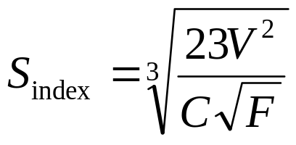
  Air currents and methane emission should be controlled by systematic measurements of air quantities and their methane concentration.
  Special examinations for firedamp layering should be made during periods of falling barometric pressure in roadways adjacent to old workings.
  Check methane emission in ascensionally ventilated face – layering index to be judged by Middendorf formula (GlukauF – 1965)
V = Mean air velocity, m/s
C – Mean methane content (% CH4)
F – Cross-sectional area of airway at the measuring station, m2
Sindex < 2, there is probable danger of methane layering
> 2, no danger

Slide 54
2. Measures against ignition of flammable firedamp mixtures:
All persons should be prohibited from carrying smoking articles, matches or other spark or flame-making devices.
All coal mines should be treated as safety-lamp mines as a number of explosions in the past had occurred in the so called naked light mines.
Only approved types of flame and electric safety lamps should be used.

Slide 55
Following precautions should be taken when using flame safety lamps:
  The lamp should be carried in vertical position.
  The glass should be protected from splashes of water.
  The lamp should not be set down on the floor but should be hung from a substantial support.
  The lamp should not be left unattended in the mine.

Slide 56
        The lamp should not be exposed to strong air currents to prevent the flame from ‘going out’.
        No combustible material should be ignited by the lamp.
        When the flame of a safety lamp indicates a dangerous percentage of gas in the atmosphere, the lamp should be withdrawn slowly, carefully, and promptly to prevent the flame from going out.
        If the flame is extinguished suddenly, the lamp should be withdrawn carefully and promptly and should be taken into fresh air and allowed to cool before relighting it.

Slide 57
Only certified flameproof and intrinsically safe apparatus should be used in coal mines.
The apparatus should be properly installed, protected, operated, and maintained.

Slide 58
To prevent ignition from electricity
  In a district, if electrically-operated equipment is not in immediate use and men are not working there, power should be cut off in that district.
  Trailing cables vulnerable to damage should be suspended from hangers and suitably protected against damage.
  To prevent ignition from electrostatic charges:
  all ventilation ductings should be earthed.
  only antistatic polythene sheeting, hoses and belts used to prevent accumulation of electrostatic charges.

Slide 59
  In endangered mine workings, a reliable methane monitor with cut-out that will be automatically cut off power supply to the electrical apparatus when the methane concentration reaches the prescribed maximum value, may be installed.
  If the main fan is stopped for any reason, electric power supply should be cut off in return airways.

Slide 60
Auxiliary ventilator not to be operated when main mine fan is stopped.
In a place ventilated with an auxiliary fan, if the auxiliary fan is stopped or fails, electrical equipment operating in the place should be stopped and the power disconnected at the source until the ventilation is restored.
The auxiliary fan should be so maintained that the impeller does not strike the casing.

Slide 61
  Excessive frictional heat produced from conveyors, brakes and bearings should be avoided by good ventilation and proper maintenance.
  Frictional sparks produced by metal-to-rock contact as with face-cutting, drilling, continuous mining and longwall power-loading equipment should be avoided.
  The cutting bits of mining machines, when they are worn or broken, are especially hazardous if they scrape against instead of cutting into the material.

Slide 62
  The precautionary measures against frictional sparking during cutting of seams by jib coal cutters :
selecting appropriate cutting horizon and lower pick speeds
wet-cutting using external water sprays directed at the ingoing and outgoing picks
providing a water mist in the cut
introducing inert gas such as CO₂ and N₂ into the cut, or ventilating the cut
adequate ventilation of the cut using compressed air

Slide 63
  Frictional ignition by ripper-type continuous miners can be considerably reduced by using carefully engineered back sprays on the ripper drum applied directly at the coal cutting bits.
  Materials constructed of light alloys to be avoided in underground coal mines to eliminate incendive sparking.
  Spontaneous heating of coal should be controlled by proper planning of mine development as well as coal extraction, good ventilation system and inspection.

Slide 64
  Blasting with explosives should be restricted to a minimum.
  Welding, flame cutting, grinding, and soldering operations etc. must be done U.G. only after checking concentration of CH₄ before and during such work and taking proper precautions
  All mobile diesel-powered equipment must be inspected and maintained in approved condition in accordance with the instructions furnished by the manufacturer.

Slide 65
3. CONTROL OF FIREDAMP EMISSION
Seams with high methane content at great depth, should be intensively worked by high production methods.
Methane drainage techniques to be applied where it is not possible to control methane concentration by general ventilation.

Slide 66
COAL DUST EXPLOSIONS

Slide 67
Coal dust, when suspended in the air as a cloud, is capable of bursting into an explosion and propagate it, even in the absence of firedamp.

Slide 68
For a coal dust explosion to take place:
  Coal dust must be of a composition which includes sufficient VM.
  Coal dust should be of necessary fineness.
  They should be in a dispersible condition in the form of a thick cloud.
  The dust cloud should be so dense that one can’t see through it. The quantity amounts to 30 to 40 g/m³ .
  A source of ignition of sufficient intensity should be present.
  Such circumstances generally exist after a firedamp explosion.

Slide 69
Development of coal dust explosion
Exact ignition mechanism not known
Common view –
  Surface oxidation of coal dust particles
  Ignition of flammable mixture of air and gases present in between the dust particles
  combustion of solid coal particles

Slide 70
Coal dust explosion develops in stages.
First stage of ignition or ‘Puff’
It is a sudden combustion process of a part or whole of air-borne dust marked by a very high temp. but without any dynamic effects.
If the whole of the dust is consumed, the combustion of dust-air mixture ends with a puff.
Main explosion
If the whole of the dust is not consumed, the puff may lead eventually to an intense main explosion.
During the transition from Puff to explosion, due to transfer of heat of combustion to the surrounding unburnt layers mainly by radiation, an increase of pressure in the burning layers takes place.

Slide 71
When the pressure exceeds a certain value, a full fledged explosion is developed in which the combustion takes place at a rapid rate.
The pressure wave developed passes through the unburnt layers ahead of explosion flame and stir up the deposited dust creating necessary fuel in the form of a thick cloud for the following flame.
Thus the dispersion of dust and flame propagation processes are intercoupled.

Slide 72
Flammability or Explosive Limits of coal dust
It is defined as its ability of coal dust, when in the form of a cloud, to spread or propagate ignition to all points where dust-air mixtures of corresponding concentration are present.
The range of flammable limits or explosive limits is very wide, much wider than in the case of firedamp mixture.

Slide 73
Lower flammability is not an absolute quantity.
Lower limit of flammability depends upon
Particle size
The chemical composition of dust
Nature and intensity of igniting source
Time of contact with the source
Turbulence of the dust cloud
Uniformity of dust dispersion
Purity of the sample
Composition of atmosphere especially methane and oxygen contents

Slide 74
Bituminous coals have LFL varies widely between 30-300g/m³.
Most violent explosions are produced when the concentration is about 10 times the lower limit (400 to 500 g/m³)

Slide 75
Ignition of coal dust-air mixture
Ignition of coal dust-air mixture is not so rapid as with gas-air mixture
A larger source of heat is required for coal dust-air mixture.

Slide 76
The ignition temperature of coal dust cloud depends on
  The rank of coal: The ignition temperature decreases as the rank of coal decreases from the anthracites to sub-bituminous coals.
  Nature and intensity of ignition source: It varies between 900 °C and 600 °C for relatively low-ash coals
  Particle size
  Moisture and ash contents : Moisture in dust particles and in surrounding atmospheres raises the ignition temp. of the dust because of heat absorption and vaporization of the moisture.
  Oxygen concentrations : With decrease in oxygen concentration, the ignition temp. increases.

Slide 77
Factors affecting development of coal dust explosions
The flammability or explosibility of coal dust-air mixtures had been the subject of many investigations carried out in
  Laboratories
  Surface experimental galleries and
  Experimental coal mines
  The experimental work was centered around the
  Origin
  Propagation and
  Control of coal dust explosions

Slide 78
Factors affecting flammability or explosibility of coal dust-air mixtures
Particle size
Dustiness of mine workings
Volatile matter content
Percentage of ash
Percentage of moisture
Oxygen Concentration
Nature and intensity of ignition source
Presence of firedamp in mine air
Turbulence
Surrounding Conditions

Slide 79
Particle size:
The finer the dust, the greater is its surface area per unit mass and greater is its inflammability.
Coal dust particles up to 750 to 1000 μm take part in explosions depending upon the
  rank of coal,
  nature and intensity of ignition,
  oxygen concentration.

Slide 80
Most dangerous particle sizes lies between 10 to 100 μm.
Below 10 μm size, flammability reduces to a certain degree due to
  Chemical decomposition of coal dust
  Tendency to agglomerate and
  Rapid oxidation on initial exposure to air thereby becoming less easily ignitable

Slide 81
Dustiness of mine workings:
The dust cloud must be dense immediately surrounding the ignition source so that one can not see through it.
Minimum density of a dust cloud which will propagate an explosion depends on the
  Nature of the ignition source
  Fineness of the dust
  Rank of coal

Slide 82
A mine working is dangerously dusty if it contains 100 – 120 g/m³ and most violent explosions occur at 300 to 400 g/m³.
The thermal ignitability curve for a coal dust showing the relationship between Ignition temp and coal dust concentration shows that the minimum value of the ignition temp. approaches asymptotically at the higher dust concentrations.

Slide 83
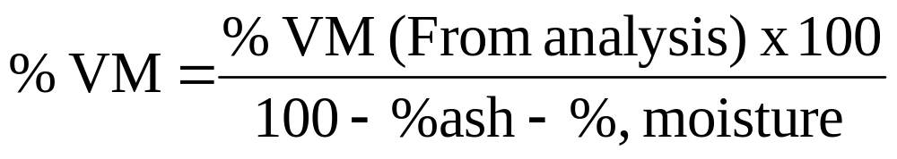
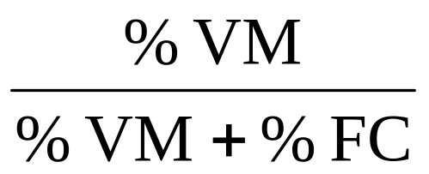
Volatile matter content:
Flammability increases with increasing combustible volatile content.
The volatile matter is usually calculated on dry, ash free basis by the formula
right hand side of above formula may be written as
Known as volatile – Combustible ratio or simply volatile ratio of coal

Slide 84
Several investigations had shown that coal dusts with
VM < 10% - non-inflammable
VM → 10 – 14% - less inflammable
VM > 14% highly inflammable

Slide 85
Percentage of ash
Increase in ash content or presence of inert foreign material reduces the ignitibility or flammability of coal dust because of heat of absorption.
Stone dusting in coal mines functions on this principle which is a practical application of the use of inert dust to prevent an explosion from taking place.

Slide 86
Percentage of moisture
Moisture in dust particles raises the ignition temperature of the dust.
It exerts a cooling effect because heat is absorbed during its heating and vaporization, thereby reducing the energy available for ignition of the dust cloud.
coal dusts containing 25 to 30% moisture tends to wet and agglomerate the fine particles and reduces their dispersability.
Effect of moisture on flammability is unimportant below < 10%.

Slide 87
Oxygen Concentration
Variation in O₂ conc. affect the ease of ignition of dust clouds and the explosion pressure.
With decrease in O₂ concentration, the ignition energy required increases, ignition temp. increases and maximum explosion pressure decreases.

Slide 88
Nature and intensity of ignition source
The nature and intensity of ignition source e.g.
  temperature,
  size of spark or flame etc.
  exert a great influence on the flammability of mine dust as they determine the dust-raising capacity and turbulence induced within the cloud.
Explosions initiated by strong sources develop faster and cause more damage than explosions initiated by weak sources.

Slide 89
Presence of firedamp in mine air
The flammability of coal dust increases almost directly in proportion to the % of firedamp.
Presence of firedamp in air in % less than its lower limit reduces the lower explosive limit of coal dust.
1% CH4 (by vol.) in 1m³ of air is equivalent to about 12 g of coal dust.

Slide 90
Turbulence
The rate of combustion reaction depends on how intimately dust and O₂ are mixed.
Turbulent mixing of dust and air result in most violent explosion.

Slide 91
Surrounding Conditions
The surrounding conditions e.g.
The size,
shape,
constrictions,
obstructions,
branching,
length and nature and condition of the surfaces of mine workings
exert an important influence on the coal dust explosions as they increase or decrease the progress of flame by holding or releasing the pressure.

Slide 92
Causes of coal-dust explosions in mines

Slide 93
For a coal dust explosion to take place in mines, two conditions must be fulfilled:
  The dust must be present as a dense cloud and
  A source of ignition in the form of flame must be present.

Slide 94
The various causes of direct ignition of a dust cloud can be classified under
  Naked flames
  Friction
  Electrical sparks
  Firedamp explosions

Slide 95
  Naked flames
  It is the easiest means of igniting a dust cloud as the source of heat is of considerable size and a large part of the dust can be heated.
  Friction
  Hot surfaces as a result of mechanical friction, such as overheated bearings, may ignite surrounding explosive dusty atmospheres.

Slide 96
Electric sparks
Sparks from short-circuiting and arcing at electrical equipment or overheated trolley wire may ignite an explosive dust-air mixture.
Static electric sparks can also ignite explosive dust-air mixtures.
Fine particles of dust may readily become electrified by friction with air or ducting through which they pass.
Under suitable conditions, a discharge or sudden recombination of separated positive and negative charges can occur which can act as a source of ignition.

Slide 97
Firedamp explosions
It is the commonest source of initiation of a coal-dust explosion.
Besides posing the danger of direct ignition, a firedamp explosion may raise the deposited dust from the mine floor , sides or roof into mine air very quickly before its flame has ceased and then propagate as a coal-dust explosion.
A very small gas explosion initiated by accidental ignition of a small quantity of firedamp mixture (approx. 0.4 m³ vol.) may thus bring about a much bigger coal-dust explosion.
It is significant that most firedamp explosions do not develop into coal-dust explosions due to their failure to raise a sufficiently dense dust cloud.

Slide 98
Prevention and suppression of coal-dust explosions
It is much easier to prevent a coal dust explosion being initiated than arrest one.
The measures for prevention and suppression of coal-dust explosion can be divided into the following three groups:
  Measures which prevents or reduce formation and dissemination of coal dust underground
  Measures against ignition of dust accumulation
  Measures against explosion propagation

Slide 99
1. Measures which prevents or reduce formation and dissemination of coal dust underground
Elimination of coal dust in mines is the logical means of eliminating coal-dust explosion hazard.
The following important measures should be adopted to reduce the formation, distribution, and accumulation of dust in mine workings
WATER INFUSION
  Water infusion of the coal face at normal (5-20 atg) or high (80-250 atg) water pressure.
  The effectiveness of coal face infusion depends on the amount of water injected and its uniform distribution in coal.
  The amount of water required lies between 8 and 10 litres per solid cubic meter coal.

Slide 100
  ‘Wet winning’ of coal using wet pneumatic picks.
With machine cutting,
  using sharp picks of suitable type,
  selecting optimal cutting traveling speeds of the machine,
  using wet-cutting.
During blasting in coal
use of stemming cartridges of CaCl2 powder containing 82-85% CaCl2 and 15-18% water reduces dust production.

Slide 101
With power loading, using conventional shearer loader
  by using sharp picks of suitable type and pick lacing,
  selecting suitable drum design, optimal rotational speed of drum, traveling speed of the machine and proper direction of drum rotation;
  introducing water to the pick clearance line through hollow drum shaft
  flushing the cutting edge of the picks from jets located either in or close to the pick boxes,
  using external water sprays during cutting.
  Internal water sprays with a water pressure greater than 15 kg/cm² have been found to be more effective than external water sprays.

Slide 102
Wetting through coal pile before it is manually or mechanically loaded.
Using proper type of conveyors with which the dust production is minimum.
Covering the total length of conveyor with a hood.
Water spraying at transfer and loading points and improving their design.

Slide 103
Preventing spillage and degradation of coal during transport in roadways by
  Using undamaged dust tight cars
  Avoiding overloading so that it will not spill in transit
  Water spraying the full and empty trains during their transit.
  Maintaining the haulage track in good condition

Slide 104
  On coal conveyor roadways, reducing spillage by
    selecting suitable capacity conveyor as well as proper belt width and speed
    providing adequate bunker capacity at loading points, and
    centralizing the flow of coal.
Proper ventilation
Restricting velocity of air current in mine airways to less than 3 m/s.
Adopting homotropal ventilation.

Slide 105
Preventing dust accumulations in mine workings by
  dry suction at loading and unloading points at which large quantities of dust are produced and can not be suppressed in the ordinary way.
  Cleaning systematically and regularly main haulage roads and main return airways of dust (3 to 4 times a year) by transportable roadway suction apparatus.
  Regularly cleaning at and near transfer and loading points.
  Locating dry coal preparation plants far away from down cast shafts (not less than 80m)

Slide 106
Selecting a method of winning with which the dust production is less.
Controlling caving of roof coal in thick seam mining using sub-level caving method.
Consolidating the floor dust to prevent it from being raised.

Slide 107
2. Measures against ignition of dust accumulation
Measures against ignition of flammable firedamp mixtures.
Neutralization and consolidation of dust at working faces within a radius of 10 to 20 m before shotfiring by means of inert water or stone dust.
Neutralization of dust in roadways by means of water, stone dust, and hygroscopic salts.

Slide 108
3. Measures against explosion propagation
The protective measures which have been found in practice to have
varying degree of effectiveness in arresting explosion propagation are:
generalized wetting of coal dust
generalized stone-dusting
stone dust barriers
explosion stoppings
salt zones
water barriers
triggered barriers

Slide 109
Generalized wetting of coal dust
It is an effective means of arresting propagation of coal-dust explosions in dry mine workings.
For water to be effective it must be present in sufficient quantity and be mixed intimately with coal dust.
The percentage of admixed water required to prevent propagation of a coal-dust explosion depends on
The fineness of the dust
Strength of the igniting source
Volatile content of coal and
Amount of stone dust present
It should not be less than 50%.

Slide 110
In practice, coal dust is wetted by washing excessive deposits of it on the side and roof surfaces to the floor by means of hoses, thereby converting the dust into mud.
To increase the wettability of coal dust which does not absorb water readily, a wetting agent may be added to the water.
The disadvantage of water as an inert for neutralizing the coal-dust explosion hazard are:
  Requires sufficient quantity of water streams for continuous wetting.
  Relative humidity of mine atmosphere is increased.
  Heaving of floor, if soft, occurs.
  Cost of the plant is high as the entire mine workings must be equipped with water mains.

Slide 111
GENERALIZED STONE-DUSTING

Slide 112
It consists of applying stone dust on the sides, roof, and floor of all mine workings except those within 10 m or less of all working faces so that it overlays the deposited coal dust and thus prevents the latter from being ignited or taking part in an explosion.
Stone-dusting is not required in a mine or part of it if
  it is naturally ‘too wet’ (condition wherein water exudes if a ball of dust is squeezed in the hands) or
  It is too high in incombustible content to propagate an explosion.

Slide 113
In 1891, British Engineer W. Garforth first observed that an explosion did not propagate to a part of a mine which was well stone dusted.
With this observation, stone-dusting began in Britain and officially adopted in 1920.
Stone-dusting was officially adopted in France in 1911 and in Germany in 1926.
Today, generalized stone dusting is done in mines of almost all coal-mining countries of the world.

Slide 114
The value of stone-dust application is due to the following facts:
When coal dust is mixed with enough incombustible dust, it will not explode or assist in propagation of an explosion.
When incombustible dust is raised into an explosion flame in a sufficiently dense cloud, it gets heated up taking away heat from the flame.
Greater the amount of stone dust in the flame, greater is the cooling effect.
The incombustible dust also serves to shield or blanket the coal dust particles from heat of radiation so that they do not take part in combustion any more.

Slide 115
As coal dust is constantly produced as a result of mining operations and get deposited by ventilating currents in mine workings, one application of stone dust will not suffice to keep the mine workings immune from explosions.
Stone-dusting must be applied at regular intervals of time after it has been first applied.

Slide 116
Minimum incombustible content (by mass) required by the coal dust depends on
  Characteristic of the coal especially its VM content
  Fineness of the dust and
  Percentage of CH4 present in the mine atmosphere
Requirement of min. incombustible matter in coal dust
  In India – 70%
  In FRG – 80% and
  In USA – 65%

Slide 117
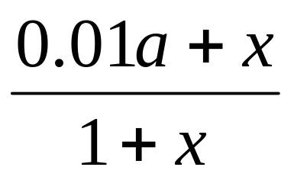
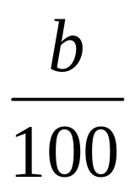
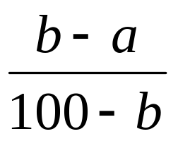
For a given coal, the quantity of stone dust to be applied in mine workings can be calculated from the following relation:
=
Or
x =
where
x = quantity of stone dust required (kg of stone dust/kg of mine dust)
a = percentage of incombustible matter already present in the mine dust
b = prescribed minimum percentage of incombustible content
About 3 to 7 kg stone dust per tonne of coal output is required.

Slide 118
Characteristics of suitable stone dust
Fineness
It should not be hygroscopic so that it does not cake.
Dispersibility: Should be readily dispersible into the air when blown by mouth or by suitable appliance.
Combustible matter present
It should be soluble in the fluids of the lungs.
It should be as light in colour as possible and preferably white.

Slide 119
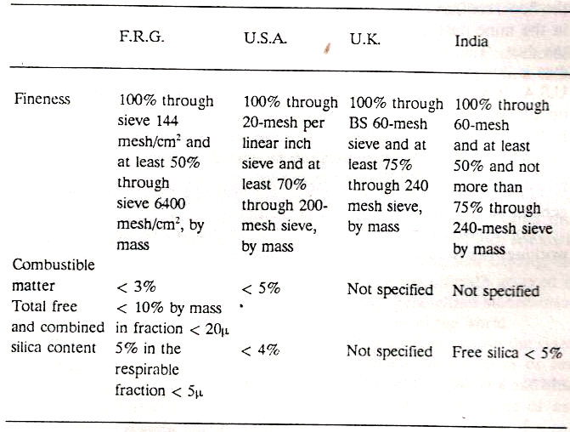
Table: Specifications of stone dust in some countries

Slide 120
Standard stone dust is prepared in special mills out of
Shale
Dolomite
Gypsum: Most effective of all
Limestone: most commonly used in mines throughout the world due to its
  Cheapness
  Easy availability
  White colour
  Low silica content and
  Little tendency to cake

Slide 121
Stone dust application
Stone dust can be applied
  By hand or
  By mechanical means using stone dusting machines

Slide 122
Hand stone-dusting
A man can stone dust 15 to 20 m of a roadway, 9 to 11 m² in cross-section, per shift.
Hand-dusting by hand scoops is
Cumbersome
Has low capacity
Does not ensure even distribution of stone dust over the roof and sides and
Not suitable for large or mechanised mines.

Slide 123
Mechanised dusting/mechanised spreading of dust
  It is ideal for large and mechanised mines.
  It is most economical
  Efficient and
  Rapid method

Slide 124
Stone dusting machines/stone dust distributors
They blow fluidised dust on to mine surfaces through tubing or hose of up to 200 m long.
They may be of
  Low pressure type: portable machines which can be moved from one face to another for face-area stone dusting as soon as a face is loaded out.
  High pressure-machines: have dust capacities up to one tonne per minute.
    Used for applying dust in intake and return airways as well as in face areas.

Slide 125
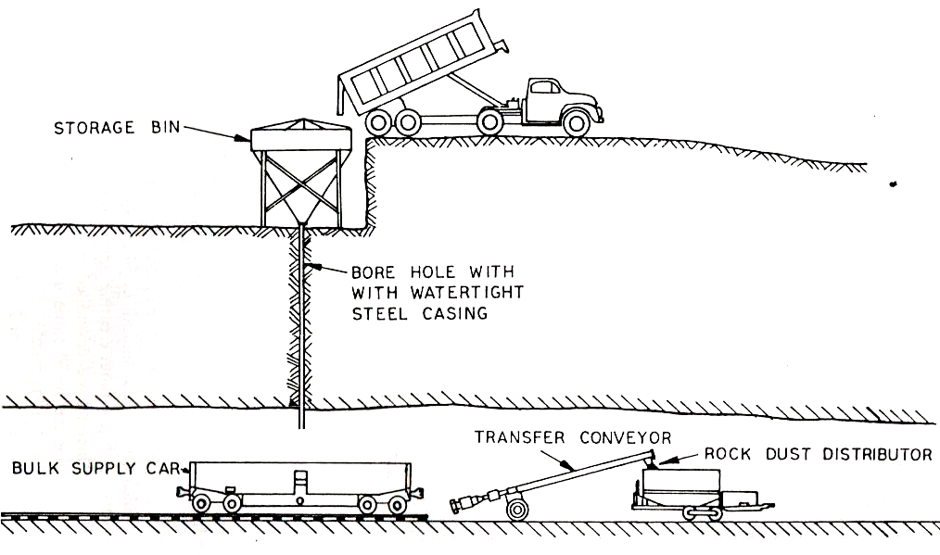
MSA bulk rock-dusting system

Slide 126
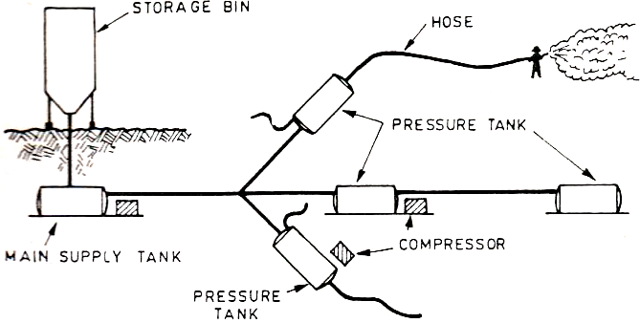
MSA pressure tank automated rock-dusting system

Slide 127
Effectiveness of wet stone dusting in arresting propagation of explosion:
Experiments carried out in US Experimental Coal Mine has shown that:
A mixture of 20-30 litres of water with about 45 kg dust gives good results from the standpoint of adherence.
Wet stone dust should be applied at a rate of not less than 0.92 kg/m² of surface area to yield a good covering of the side-roof surfaces.

Slide 128
Rate of drying of the stone dust varies with the air velocity and relative humidity.
With normal air currents and relative humidity below 80-90%, it dries in about a week.
Wet stone dusting is less effective than dry stone dusting in arresting the propagation of an explosion.

Slide 129
STONE DUST BARRIERS

Slide 130
Stone dust barrier is a device which uses the dynamic pressure of explosion to release and disperse a mass of stone dust in the form of thick cloud into the path of an on-coming explosion flame thereby smothering the flame.

Slide 131
Stone dust barriers, the means of suppression of coal dust explosions, were first proposed by M. J. Taffanel and today extensively used in Indian and many overseas mines.

Slide 132
Location of stone dust barriers
Installed at strategic locations of the mine such as
  Roadways leading from shafts or pit bottoms.
  In all levels and inclined roadways including gate roads and development heading and
  Near roadway junctions

Slide 133
Barrier design
The shelf barrier consists of a no. of dust-laden shelves.
Independently supported transverse to and along the roadway in which it is installed.
It occupies a length of 25 to 40 m of the roadway.
Two design of shelves are commonly used in mines

Slide 134
  The German shelf and
    Consists of several loose planks, max. 60 cm long and10-15 cm wide
  The Polish shelf
    Consists of several short planks 35-50 cm long and 10-15 cm wide
  In German mines, both German and Polish shelves are approved.
  In UK and India, Polish shelves are only permitted.

Slide 135
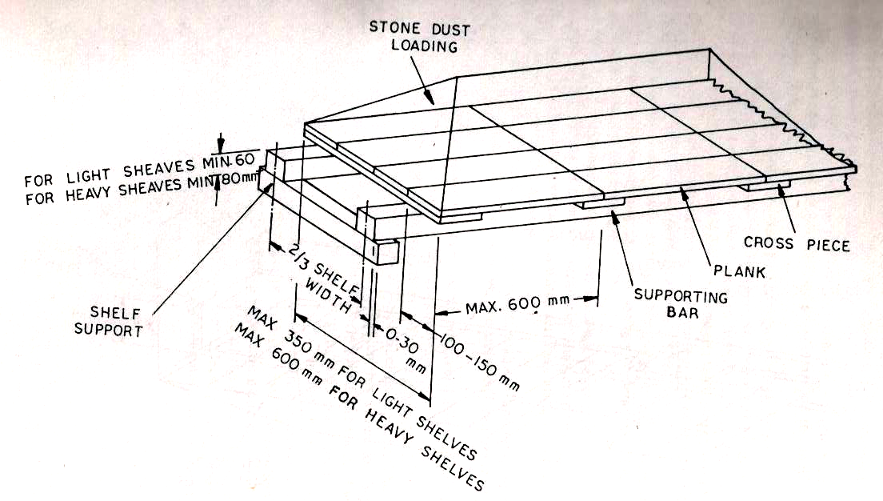
German Shelf

Slide 136
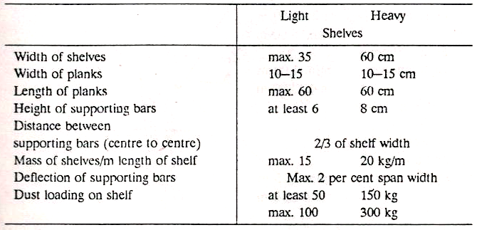
Specifications of the light and heavy German shelves

Slide 137
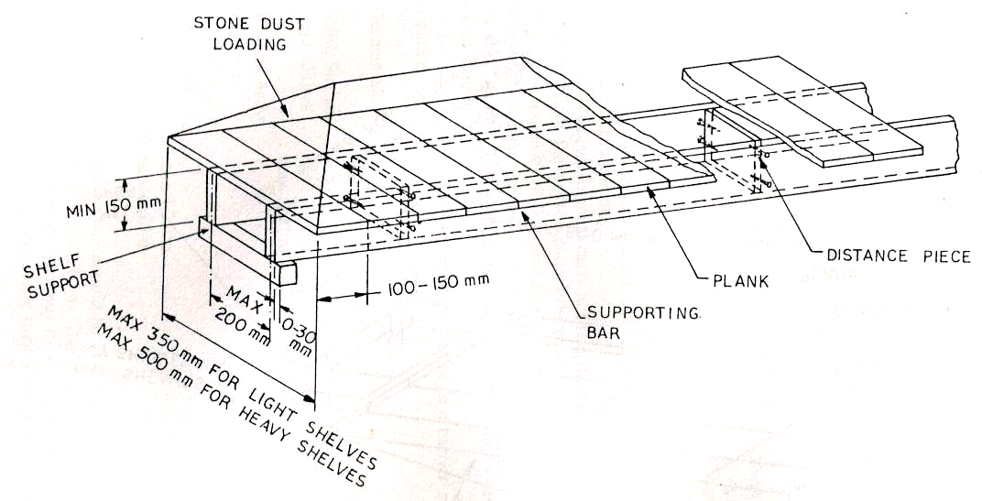
Polish Shelf

Slide 138
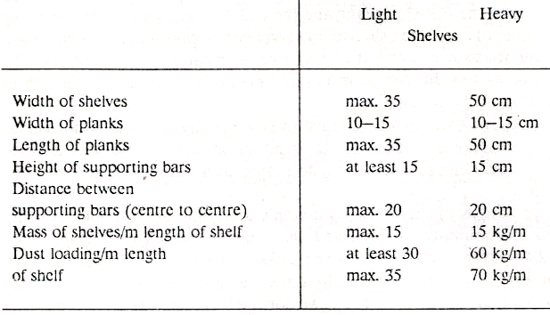
Specifications of the light and heavy Polish shelves

Slide 139
Rules for erection of stone dust barriers in German Mines
A stone dust barrier must carry not less than 400 kg stone dust/m2 of the roadway in which it is installed.
Distance between the adjacent shelves of a barrier :
German shelves
Min. 1.5 m and Max. 2.0 m
Polish shelves
Light shelves: min. 1.0 m and max. 2.0 m
Between heavy shelves or between a heavy and a light shelf: min. 1.25 m and max. 2.5 m

Slide 140
Bottom of the shelves should be at a height greater than half the roadway height but not exceed 2.6 m.
Clearance between the ends of the shelves and the sides of the roadway should be at least 5 cm.
Brackets supporting the entire shelf must be rigidly fixed to the ground or roadway support.
The shelf should never be suspended from chains or wire ropes which tend to swing.
The shelf supports at the brackets must be horizontal and have a smooth bearing surface.
They should not project beyond the shelf supports more than 3 cm.

Slide 141
The supporting bars must be rectangular in section.
The gaps between the planks must be covered with thin strips having max. width equal to the width of the planks.
The clear space between the top of the dust loading and the inner edge of the roof bar or crown segment of the steel arched support may be at least 15 cm.
Dust loading must be approx. symmetrical with respect to the centre of the roadway and must occupy atleast two-thirds of the max. width of roadway.

Slide 142
Dust loading on the shelves must not be covered.
In the vicinity of a barrier, ventilation ducting, overhung belt conveyors, pipes and other obstructions which seriously affect the effectiveness of a barrier must not be present.
Barriers should not be installed at roadway junctions, curves, or in widened persons. They can however, be installed near roadway junctions.
Distance between barriers should not exceed 200 m in gate roadways of longwall faces and 400 m in main roadways.

Slide 143
Efficiency of stone-dust barriers
Studies shown that efficiency of a stone dust barrier depends on the time interval between dust discharge and flame arrival which depend upon
  The design and location of the barrier.
  Presence of firedamp-air mixture and
  Intensity of explosion

Slide 144
A weak explosion may not through the shelves off their support.
If the time interval between dust release and flame arrival is too long, a greater part of the dust falls to the floor. If it is too short, the dust does not get adequately dispersed.
A time interval of 0.1 to 0.2 s is sufficient enough to create a flame quenching cloud.

Slide 145
Failure of stone-dust barrier
When barrier itself lies in a flammable firedamp-air mixture or firedamp occurs at the as a roof layer.
When flame velocities are high (more than 500 m/s) as when an explosion is initiated by a powerful firedamp explosion.
When the barrier is located less than 40-60 m or far from a face or other potential point of ignition so that the dynamic pressure is less than the min. required and normally lies between 3-5 Kn/m2.
When an explosion is initiated by a weak ignition source and sufficient dynamic pressure is not built up.

Slide 146
Water Barriers

Slide 147
Since the early 1960s, water barriers, also called water-trough barriers are being used as alternative to stone-dust barriers for suppression of coal-dust explosions in mines.
At present, water barriers are widely used in the West German coal mines.

Slide 148
Performance tests of water barriers carried out in Tremonia Experimental Mine, FRG showed that
  in quenching explosion flame, water barriers are roughly equivalent to the stone-dust barriers.
  200 litres of water per sq. m of roadway cross-section has the same effect as 400 kg stone dust per sq. m on German shelves.

Slide 149
Advantages of water over stone dust
Its heat capacity (latent heat of water = 539 cal/g) is about 5 times that of dust.
Efficiency is not affected by underground climatic condition.
Easily available in all mine roadways.

Slide 150
Constructional features of water barrier
Consists of a no. of water-filled troughs or containers of suitable material supported on horizontal shelves in the vicinity of the mine roof.
The containers shatter or burst under the action of pressure wave or shock wave ahead of the propagating flame of an explosion releasing and dispersing water in all directions in the path of the explosion flame.

Slide 151
Types of water barrier
Depending on the method of support of troughs, two types of barriers have been approved
Type 1
  Troughs are supported with their total upper lip surface resting on transverse supporting frames.
Type 2
  Troughs are placed over transverse bars.

Slide 152
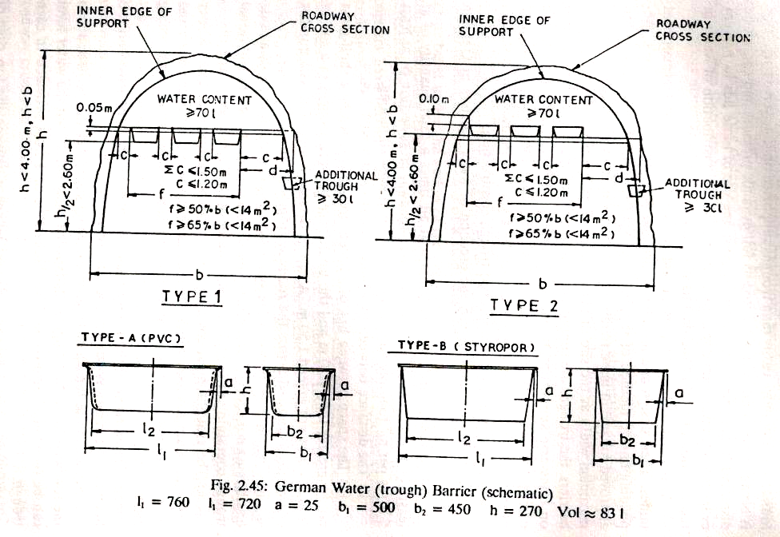

Slide 153
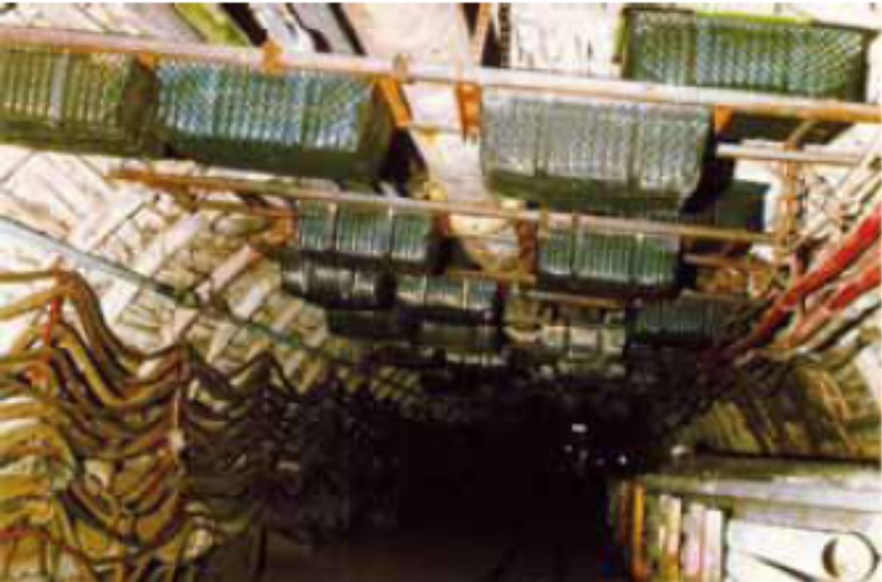
Fig. Water Barriers

Slide 154
Shattering of the water troughs is influenced by
  Magnitude of the dynamic pressure
  Trough material used
  Trough shape
  Method of installation and
  Trough lid or covering
Troughs made of certain verities of hard PVC or foamed polystyrol have been found most suitable.
They are easily shattered at low wind pressures giving good water distribution.

Slide 155
Design and installation of water-barrier
Troughs must be designed so that they maintain their shape.
Troughs with approval certificates should only be used.
Method of installation of the troughs in roadway cross-section exercises a great influence on the shattering of the troughs.
Troughs placed with their longer axis at right angles to the roadway axis offer greater frontal area to the dynamic pressure than they are placed parallel to the axis of the roadway.
Troughs supported in the roadway with their edges resting on transverse supporting frame have been found to shatter easily than troughs supported on transverse bars.

Slide 156
Rules for erection of water barriers in German Mines
Water barriers must contain at all times atleast 200 liters of water per sq. m roadway cross-section or at least 5 liters per m³ roadway volume and at least 20 m long.
Distance between two shelves must be at least 1.2 m.
Space between lips of adjacent troughs carried by a shelf must not be greater than 1.2 m and total space between troughs in a row of troughs must not exceed 1.5 m.
Distance between outer troughs of a row and roadway side or rib must not exceed 1 m.
Where this distance exceeds 1 m, an additional trough containing 30 liters of water must be installed at the rib.

Slide 157
At the site of installation, troughs must cover at least 50 % of max. roadway width for roadway cross-sections up to 14 m², and 65% for roadway cross-sections exceeding 14 m².
Bottom of the troughs must be at a height of at le half the roadway height but not exceed 2.6 m.
When the top lip or edge of the troughs is higher than 1.7 m above the roadway floor, arrangements must be made for recognizing water level by marked graduations or float provided in each trough.
With Type 2 barriers, the space between the top edge of the trough and the inner edge of the roof support must be at least 10 cm.

Slide 158
Troughs must carry at least 70 litres of water.
At all places where barriers are installed, water from a water pipe must be available. Water hoses must be provided.
Water barriers must be located at least 100 m away from stone-dust barriers.
Distance between the barriers must not be greater than 200 m in gate roadways and 400 m in main roadways.

Slide 160
Failure of water barriers
Water barriers can be ineffective when
An explosion initiated close to (less than 40 m) or far from the barrier.
When an explosion is initiated by a weak ignition source resulting in a weak or slow-moving explosion with flame speed less than 76 m/s.
When an explosion is very strong or violent so that the time lapse between the arrival of pressure wave at the barrier is too short (less than 0.1 s) to disperse water into the roadway cross section.
When an explosion spreads in to an adjacent roadway through interconnecting crosscuts.

Slide 161
Triggered Barriers

Slide 162
Stone-dust and water barriers suffer from the disadvantages that they depend for their action on the dynamic pressure generated by the explosion.
Triggered barriers started in 1966 whose operation is independent of pressure.

Slide 163
Constructional features:
Consists of
  A sensor or detector
  A disperser and
  An extinguishing agent

Slide 164
The sensor or detector
It is located upstream of the disperser.
It detects a developing explosion and sends a signal to the disperser which disperses the extinguishing agent into the path of the explosion flame.
Of two types:
  Photo-electric (IR and UV) sensors and
  Thermocouple sensors.

Slide 165
The sensor should be sufficiently sensitive to react to temperature change or to radiation from the flame of any size of explosion.
On the other hand, it should not react to extraneous effects and influences, viz. due to
  mechanical shock,
  cable faults,
  air-blast shocks produced from blasting,
  mine lighting and
  heat from flame lamps or other sources.

Slide 166
Its performance should not be impaired by dust, oil or water.
Ultraviolet sensors have been found to be unreliable in operation with coal-dust explosions, in which unburnt cloud of coal dust between the flame and sensor may attenuate the UV radiation to an insignificant level.

Slide 167
The disperser
The disperser disperses the extinguishing agent into the path of the explosion flame.
There are two types of extinguishant dispersion systems:
1st system:
The extinguishing water contained in a trough or
The extinguishing powder held in polythene bag.
They are dispersed by a detonating cord.

Slide 168
2nd system:
The extinguishing agent (water or powder) is contained in the disperser under stored force (pressurized nitrogen gas or Halon) and
It is dispersed when a detonator bursts the sealing disc of a quick-release valve of an inverted high pressure steel cylinder containing the suppressant water or powder and nitrogen at a pressure of 30, 60 or 120 bar.

Slide 169
The extinguishing agents
It is essential that the extinguishant is discharged at a high rate and
Time interval between the onset of discharge and flame arrival does not exceed the time necessary for full discharge.
Commonly used extinguishants are:
  KHCO₃
  Water
  Dry powders
  Halon (CF₃Br)
  Water mixed Halon (CF₃Br)

Slide 170
The relative effectiveness of the extinguishing agents has been found to be as follows:
KHCO₃ < Water < Water mixed Halon (CF₃Br) < Halon (CF₃Br)

Slide 171
Advantages of triggered barriers:
They are applicable in all regions of a mine.
They find particular application in thin seams where there is insufficient headroom for passive barriers.
They can be used to suppress firedamp explosions.
Much less extinguishant is required.
Minimum barrier maintenance.

Slide 172
Investigation of Mine Explosions

Slide 173
The evidences that may be available and collected immediately after an explosion are
Displacement of loaded mine cars, strong steel supports, machinery or other heavy objects, and
bending of steel beams may serve as the guide for ascertaining the direction in which the explosion force had traveled through the mine workings.
Charring or burning of materials sensitive to flame viz. paper, fibres of torn timber, and pieces of clothing may give valuable information on the passage of explosion flame.

Slide 174
Formation of traces of coke crust or globules on roadway supports may give indication of passage of coal-dust explosion flame and intensity of explosion.
Layering of soot deposit on horizontal surfaces would indicate the passage of coal-dust explosion flame.
Nature of death or injury of the victims whether by burning, violence, suffocation or poisoning by afterdamp may give clue to the type of explosion that have occurred.
Position of dead bodies and equipment may give valuable information on the operations being carried out.

Slide 175
Defective electrical apparatus and machinery or defective or damaged safety lamps which may pinpoint the cause of origin of explosion.
Discovery of contrabands, such as matches or other flame making devices may indicate negligence of miners as a possible cause of ignition.
Signs of blown-out shots may locate the seat of explosion.

Slide 176
Analysis of air samples collected and analyzed immediately after the explosion may give a clue to the type of explosion that might have occurred.
Immediate past history of mine and affected parts thereof from official reports/records, especially
  The ventilation difficulties
  Operation of ventilation appliances and
  Dust hazards may give general appreciation of explosion hazard existing in the mine.

Slide 177
